Slide 1
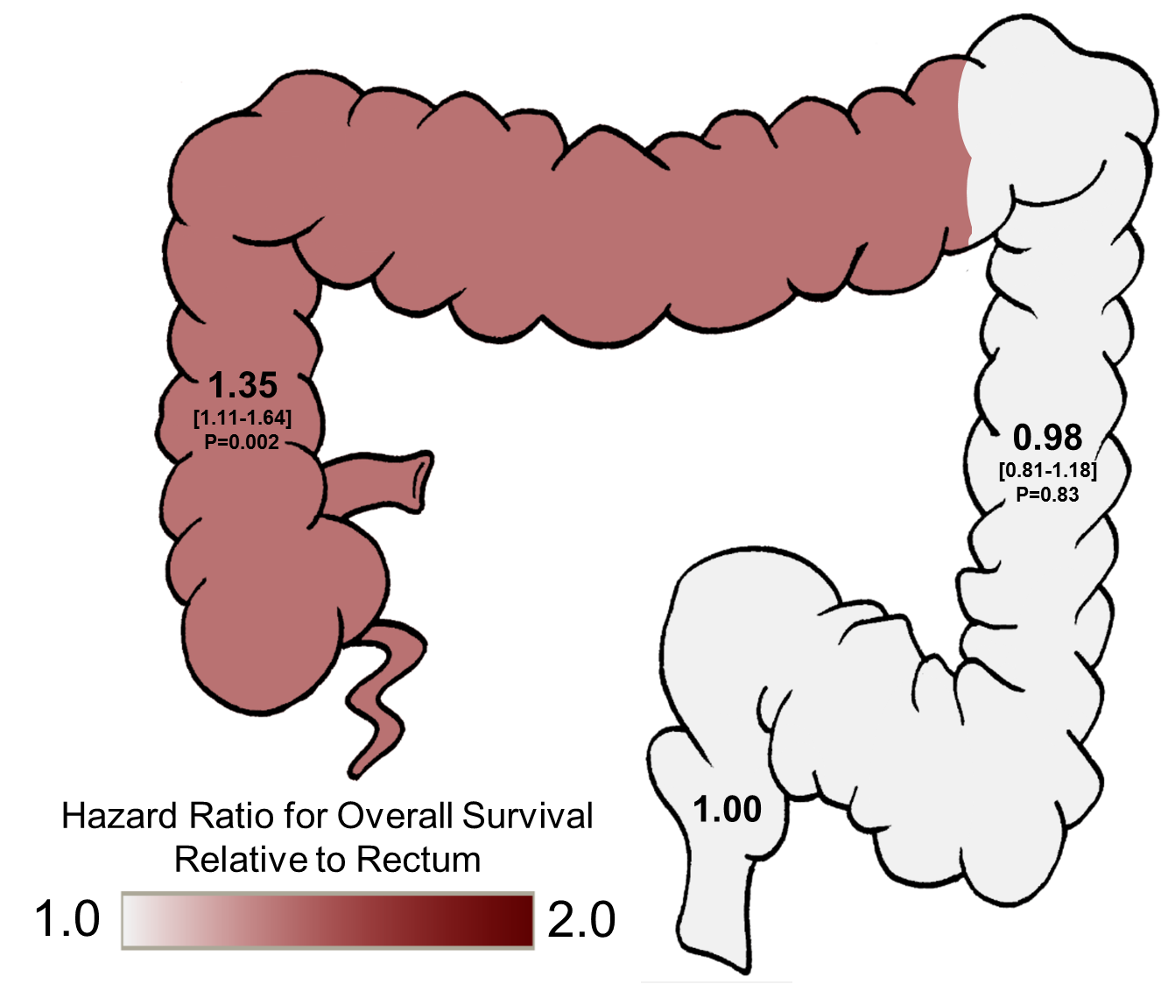
Supplemental Figure 3
Multivariate Model
Model included primary tumor location (HR shown in graphic) and non-location based variables (HR in table below). Other variables considered for inclusion in the model but with P>0.1 during model creation include included gender, MSI status, age and mutations in TP53, KRAS, PIK3CA, SMAD4, PTEN, GNAS, CTNNB1, FGFR3 and AKT1.
Non-Location Based Variables | HR (95% CI) | P
Metastatic at Diagnosis | 1.49 (1.29-1.74) | <0.0001
Mucinous/Signet Histology | 1.48 (1.24-1.78) | <0.0001
BRAFV600 Mutation | 1.89 (1.42-2.51) | <0.0001
KRAS | 1.29 (1.11-1.50) | 0.0010
Notes:
Figure 1. Comparison of overall survival from date of stage IV diagnosis in metastatic colorectal cancer stratified by (A) tumor side and (B) tumor site. All P values are relative to rectum as the reference.

